Slide 1
Join Operation
Accessing data from multiple tables

Slide 2
Goal
Write SELECT statements to access data from more than one table using equijoins and nonequijoins
Join a table to itself by using a self-join
View data that generally does not meet a join condition by using outer joins
Generate a Cartesian product of all rows from two or more tables

Slide 3
JOIN
In the SELECT, FROM WHERE statement you list the columns, the tables and the relationship between tables (WHERE)
To get data from more than one table you need to identify common columns that connects the tables
You can also specify the relationship using a JOIN clause instead of the WHERE clause

Slide 4
JOIN
A join is a SQL query that merges rows from two or more tables or views
Oracle performs a join whenever multiple tables appear in the query's FROM clause.
If multiple tables have the same column names, the duplicate column names should be qualified in the queries with their table name or table alias.

Slide 5
JOIN TYPES
Cartesian Joins
Inner Joins
Outer Joins
Natural Join
Join…Using
Join…On
Self-joins
Nonequality Joins

Slide 6
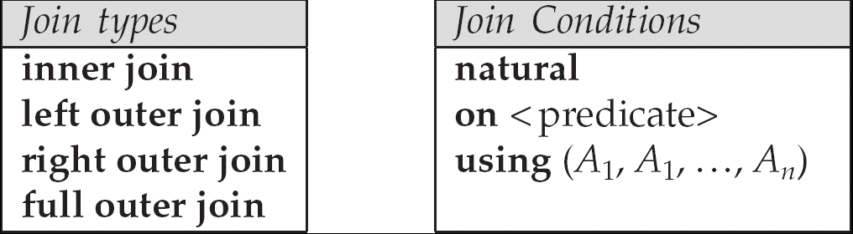
Joined Relations
Join operations take two relations and return as a result another relation.
These additional operations are typically used as subquery expressions in the from clause
Join condition – defines which tuples in the two relations match, and what attributes are present in the result of the join.
Join type – defines how tuples in each relation that do not match any tuple in the other relation (based on the join condition) are treated.

Slide 7
Cartesian Joins
A Cartesian join occurs when data is selected from two or more tables and there is no common relation specified in the WHERE clause.
If you do not specify a join condition for the tables listed in the FROM clause, Oracle joins each row from the first table to every row in the second table
Join operations take two relations and return as a result another relation.
A join operation is a Cartesian product which requires that tuples in the two relations match (under some condition).
It also specifies the attributes that are present in the result of the join

Slide 8
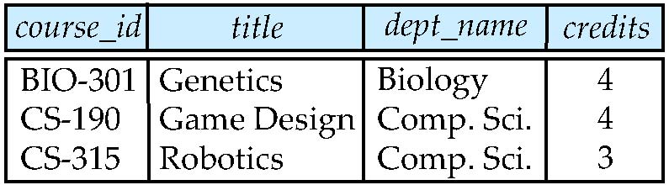
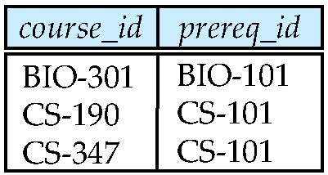
Cartesian Joins
Relation course
Relation prereq
Observe that
prereq information is missing for CS-315 and
course information is missing for CS-437

Slide 9
Cartesian Joins
Oracle Syntax
SELECT region_name, country_name FROM regions, countries WHERE countries.country_id LIKE ’J%’;
ANSI Syntax
cross join
SELECT region_name, country_name FROM countries CROSS JOIN regions WHERE countries.country_id LIKE ’J%’;

Slide 10
Inner Joins
Inner joins return only the rows that satisfy the join condition
Condition can use any of the comparison operations
When the “=“ sign is used the join called equality join or equijoin
SELECT locations.location_id, city, department_name FROM locations, departments WHERE locations.location_id = departments.location_id;

Slide 11
Inner Joins ANSI
ANSI Syntax
<table name> NATURAL [INNER] JOIN <table name> <table name> [INNER] JOIN <table name> USING (<columns>) <table name> [INNER] JOIN <table name> ON <condition>

Slide 12
Outer Join
An extension of the join operation that avoids loss of information.
To get the records from one table (left or right), even if there is no corresponding row in the joining table
Computes the join and then adds tuples form one relation that does not match tuples in the other relation to the result of the join.
Uses null values.
Oracle Syntax
(+ ) outer join – place it next to the column from the table you want to see all tuples form in the WHERE clause

Slide 13
Outer Join
If tables A and B are outer-joined (FROM A, B) and you need all rows from B, the outer join operator is placed beside all columns of A.
Right Outer Join
ANSI Syntax
FULL OUTER JOIN
RIGHT OUTER JOIN
LEFT OUTER JOIN

Slide 14
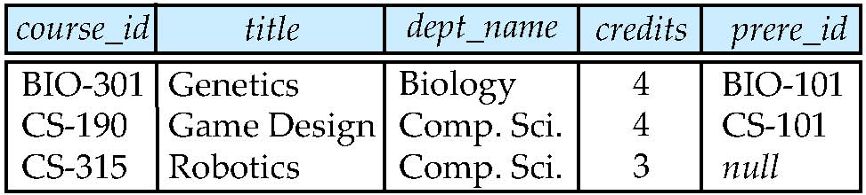
Left Outer Join
course left outer join prereq
course
prereq

Slide 15
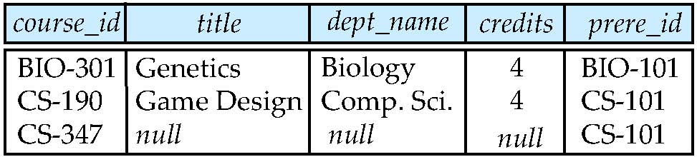
Right Outer Join
course right outer join prereq
course
prereq

Slide 16
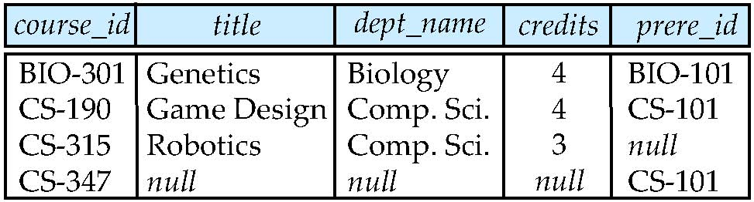
Full Outer Join
course natural full outer join prereq
course
prereq

Slide 17
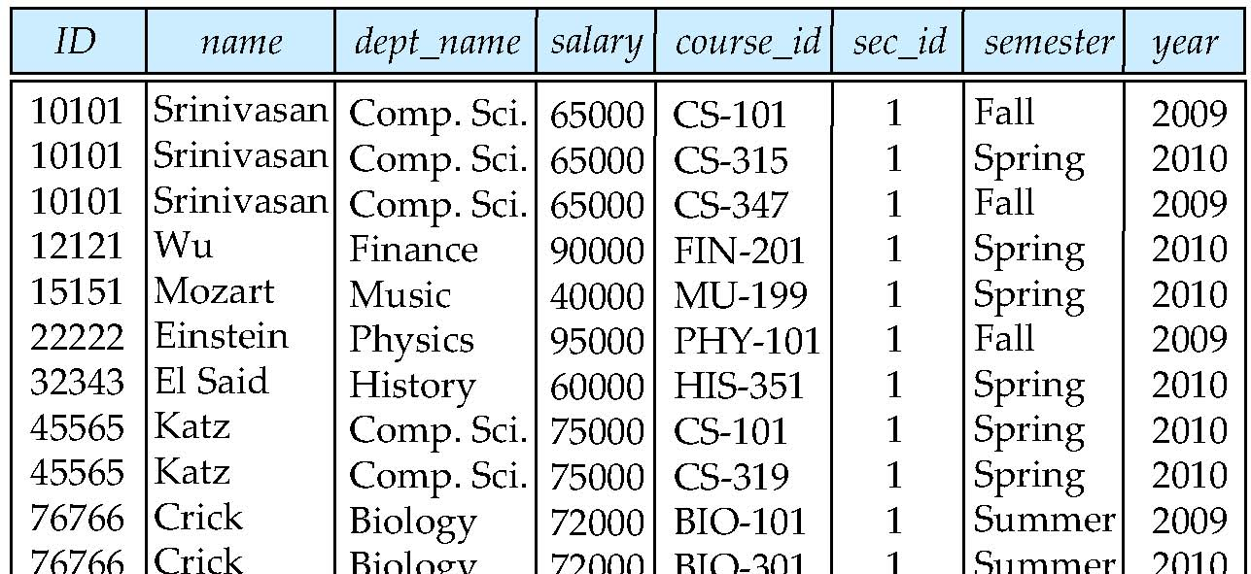
Natural Join
Natural join matches tuples with the same values for all common attributes, and retains only one copy of each common column
select * from instructor natural join teaches;

Slide 18
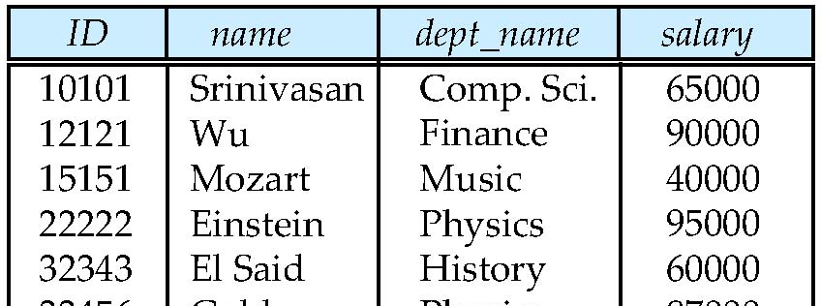
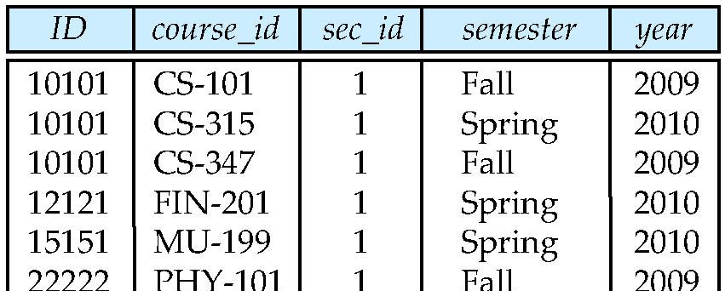
Natural Join Example
List the names of instructors along with the course ID of the courses that they taught.
select name, course_id from instructor, teaches where instructor.ID = teaches.ID;
select name, course_id from instructor natural join teaches;
instructor
teaches

Slide 19
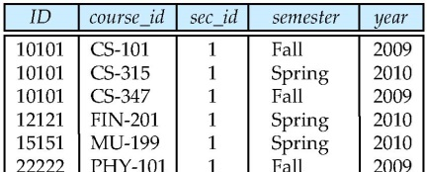
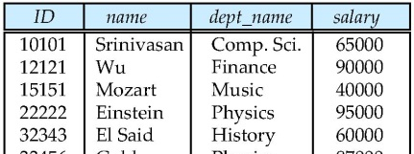
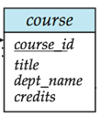
Natural Join (Cont.)
Danger in natural join: beware of unrelated attributes with same name which get equated incorrectly
List the names of instructors along with the titles of courses that they teach
Incorrect version (makes course.dept_name = instructor.dept_name)
select name, title from instructor natural join teaches natural join course;
Correct version
select name, title from instructor natural join teaches, course where teaches.course_id = course.course_id;
Another correct version
select name, title from (instructor natural join teaches) join course using (course_id);
teaches
instructor

Slide 20
Join … using
If there are many columns that have the same names in the tables you are joining and they do not have the same datatype, or you want to specify the columns that should be considered for an equijoin
SELECT location_id, city, department_name FROM locations JOIN departments USING (location_id);
SELECT region_name, country_name, city FROM regions JOIN countries USING (region_id) JOIN locations USING (country_id) WHERE country_id = 'US' ORDER BY 1;

Slide 21
JOIN…ON
When you do not have common column names between tables to make a join or if you want to specify arbitrary join conditions, you can use the JOIN…ON syntax.
SELECT region_name, country_name, city FROM regions r JOIN countries c ON r.region_id = c.region_id JOIN locations l ON c.country_id = l.country_id WHERE c.country_id = 'US';

Slide 22
Self-Joins
A self-join joins a table to itself. The table name appears in the FROM clause twice, with different alias names.
When performing self-joins in the ANSI syntax, you must always use the JOIN…ON syntax. You cannot use NATURAL JOIN and JOIN…USING
SELECT e.last_name Employee, m.last_name Manager FROM employees e, employees m WHERE m.employee_id = e.manager_id;
SELECT e.last_name Employee, m.last_name Manager FROM employees e INNER JOIN employees m ON m.employee_id = e.manager_id WHERE e.last_name like ’R%’;

Slide 23
Nonequality Joins
Using operators other than =
SELECT last_name, salary, grade FROM employees, grades WHERE last_name LIKE 'R%' AND salary >= low_salary AND salary <= NVL(high_salary, salary);
ANSI Syntax
SELECT last_name, salary, grade FROM employees JOIN grades ON salary >= low_salary AND salary <= NVL(high_salary, salary) WHERE last_name LIKE 'R%';

